Slide 1

Does R&D Investment Lead to Better Business?
An analysis of the impact of R&D investment on business performance, using NYSE data
By Minh Nguyen

Slide 2
3 ways to investigate correlation
Revenue
Operating Income
Operating Margin
Photo by Pixabay

Slide 3
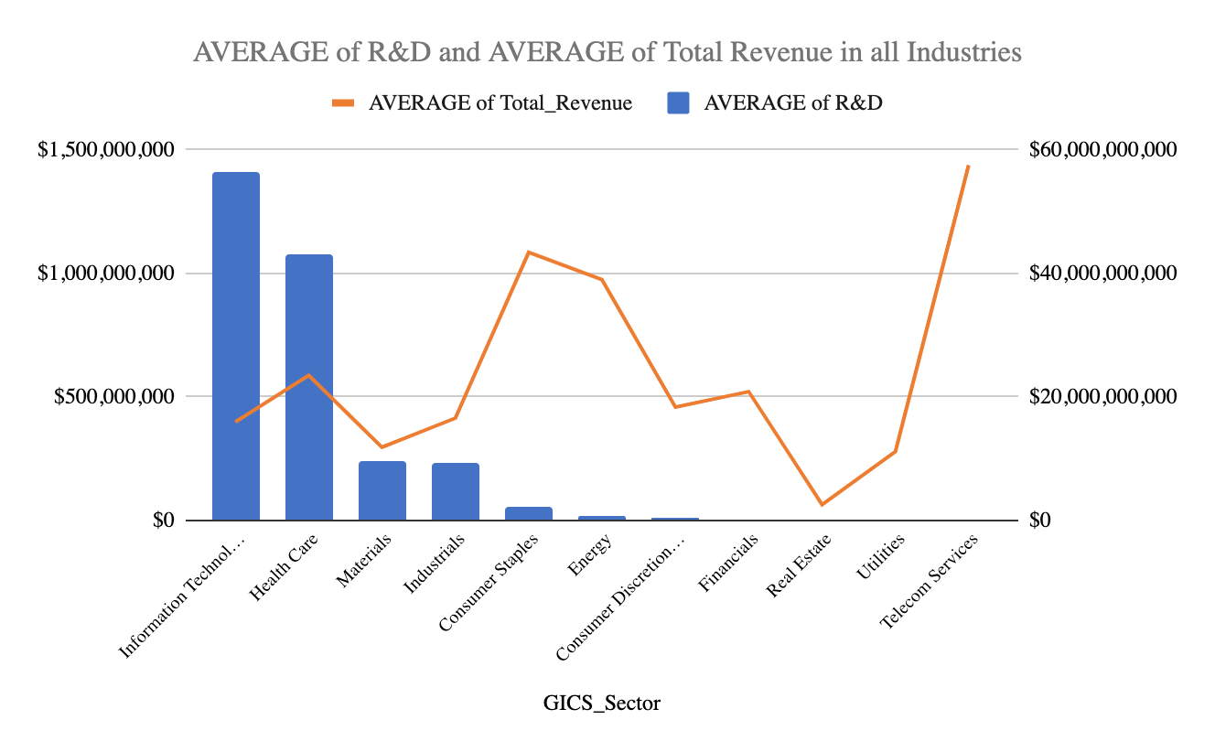
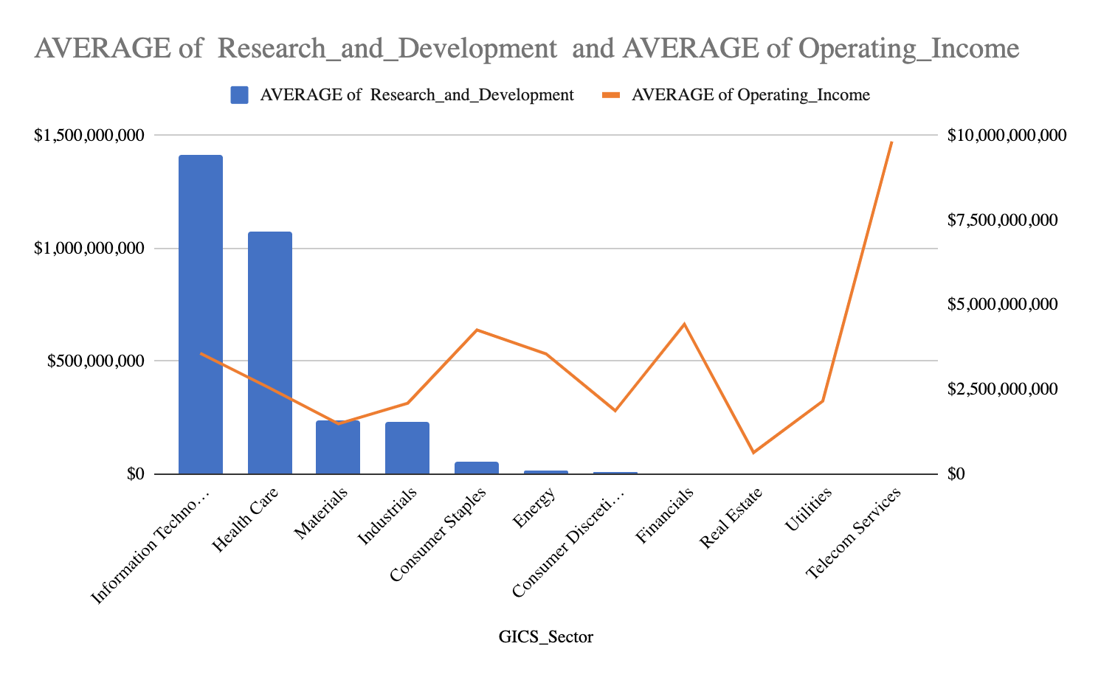
Revenue
There is no real correlation between the trend of R&D and Revenue.
We can see industries such as Telecom Services and Consumer Staples having massive Revenue of approximately 40B-60B with little to no investment in R&D.
On the other hand, industries such as IT and Healthcare which don't have nearly as much Revenue at around 20B, invest a lot into R&D.
But that's not to say the 2 variables have negative correlation, the Real Estate industry has one of the lowest amount of Revenue, but also very low on R&D.
Operating Income
Operating Income: The Operating Income chart also doesn't tell a complete story on the correlation between R&D cost and Operating Income. The line chart for Operating income is very similar to the Revenue one.
Photo by Pixabay

Slide 4
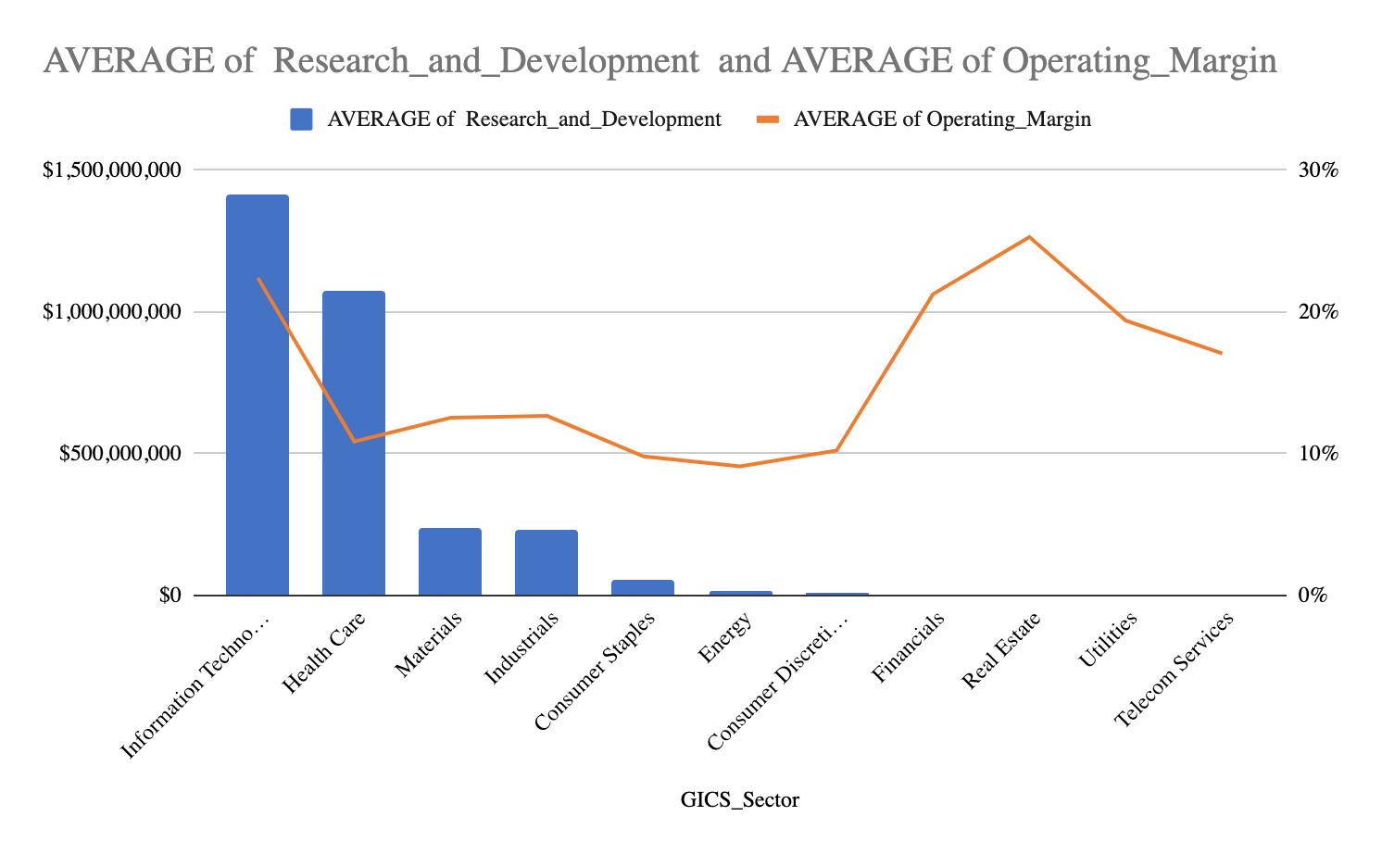
Operating Margin
Here we see some changes in compare to the 2 previous chart. IT significantly improve their number in compare to others with over 20% Margin.
Utilities and Telecom Services also still have relatively high Margin, no longer dominate others at little under 20%. This means IT products and services are relatively more expensive in compare to Utilities and Telecom.
Special speculation goes to Real Estate, despite no R&D and low Revenue, it has the highest Margin at 25%, which means it has low amount of unit sold, but each one comes with massive price, and therefore, high Margin.
Photo by Pixabay

Slide 5
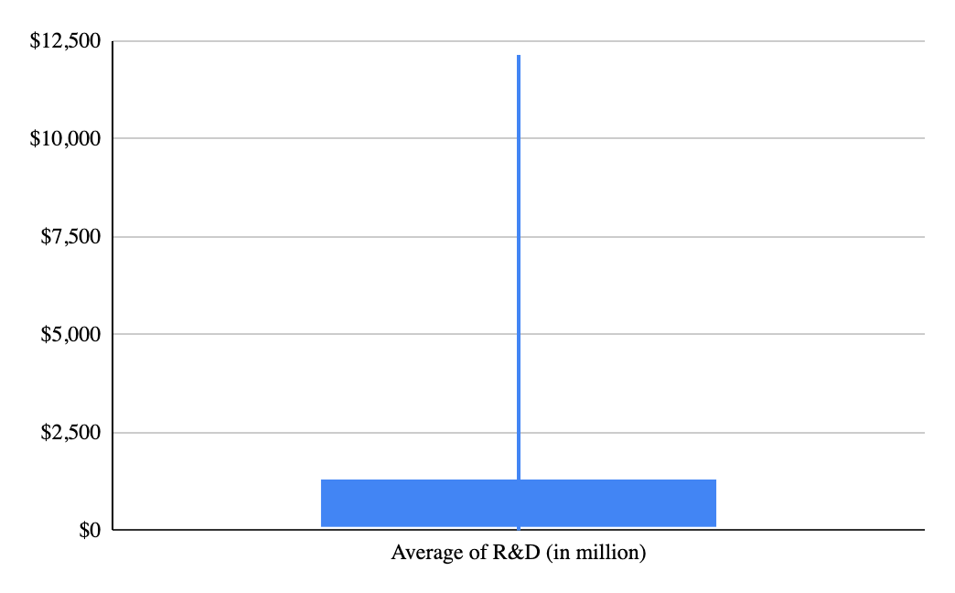
Average of R&D (in million)
minimum $0
lower $240,776,167
upper $1,262,166,667
max $12,135,000,000
standard deviation $2,556,722,718
mean $1,418,998,981
range $12,135,000,000
When taking data exclusively from IT, we can see even within the industry that focus on R&D the most, the amount of money that company spend is scattered.
Most firms spend around $137M to $1B, while some spend 6B-12B. The mean of R&D cost is 1.4B and standard deviation is 2.5B, which indicates the big range and scatterness of this statistic.
In conclusion, R&D cost doesn't have a concrete correlation to how the business is doing financially, it has more to do with the unique characteristic of the business. Even within the R&D focused industry of IT, only a select few are willing to spend big on R&D relatively to others.
Photo by Pixabay

